Slide 1
Quick Overview of GIT Workflows

Slide 2
Workflow
A workflow is a process through which a software can be developed, packaged, tested and released.
A workflow defines different stages through which a software passes from the developer to the end user.

Slide 3
Criteria
Following factors would be considered to evaluate various existing workflows:
1. Should help people involved (developers, team leads, QA, managers and end users)
2. Suitable level of complexity
3. Supports Release lifecycle (pre-alpha, alpha, beta, live)
4. Has flexibility for quick fixes for production version(s).
5. Provision for production-ready code

Slide 4
Brief overview of workflows
Name of workflow | Branches
Centralized Control | Master
GITHub Flow / Feature Branch | Master, Features
GITFlow | Master, Develop, Release, HotFix, Feature
ProGIT | Master, Develop, Feature
Forking | Master, Feature
SkullCandy | Master, Feature, QA

Slide 5
Centralized Control
Central Repository
Local Repository
Clone
Working Directory
Pull -rebase
Git status
Git add
Git commit
Master branch
Master branch
Push

Slide 6
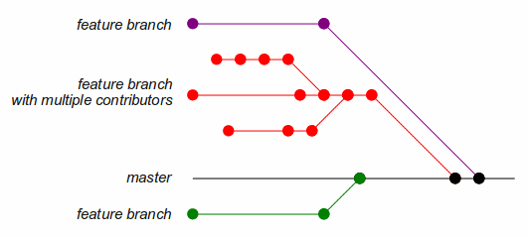
GITHub flow/ Feature Branches

Slide 7
GITHub flow/ Feature Branches
Advantages:
Promotes individual features development
Protects the main Master branch
Promotes development in team
In depth discussions on all new features before being merged into Master
Short release time
Quick response to issues/bugs reported
Disadvantages
Too flexible or ad-hoc
Lack of support for releases and lifecycle management

Slide 8
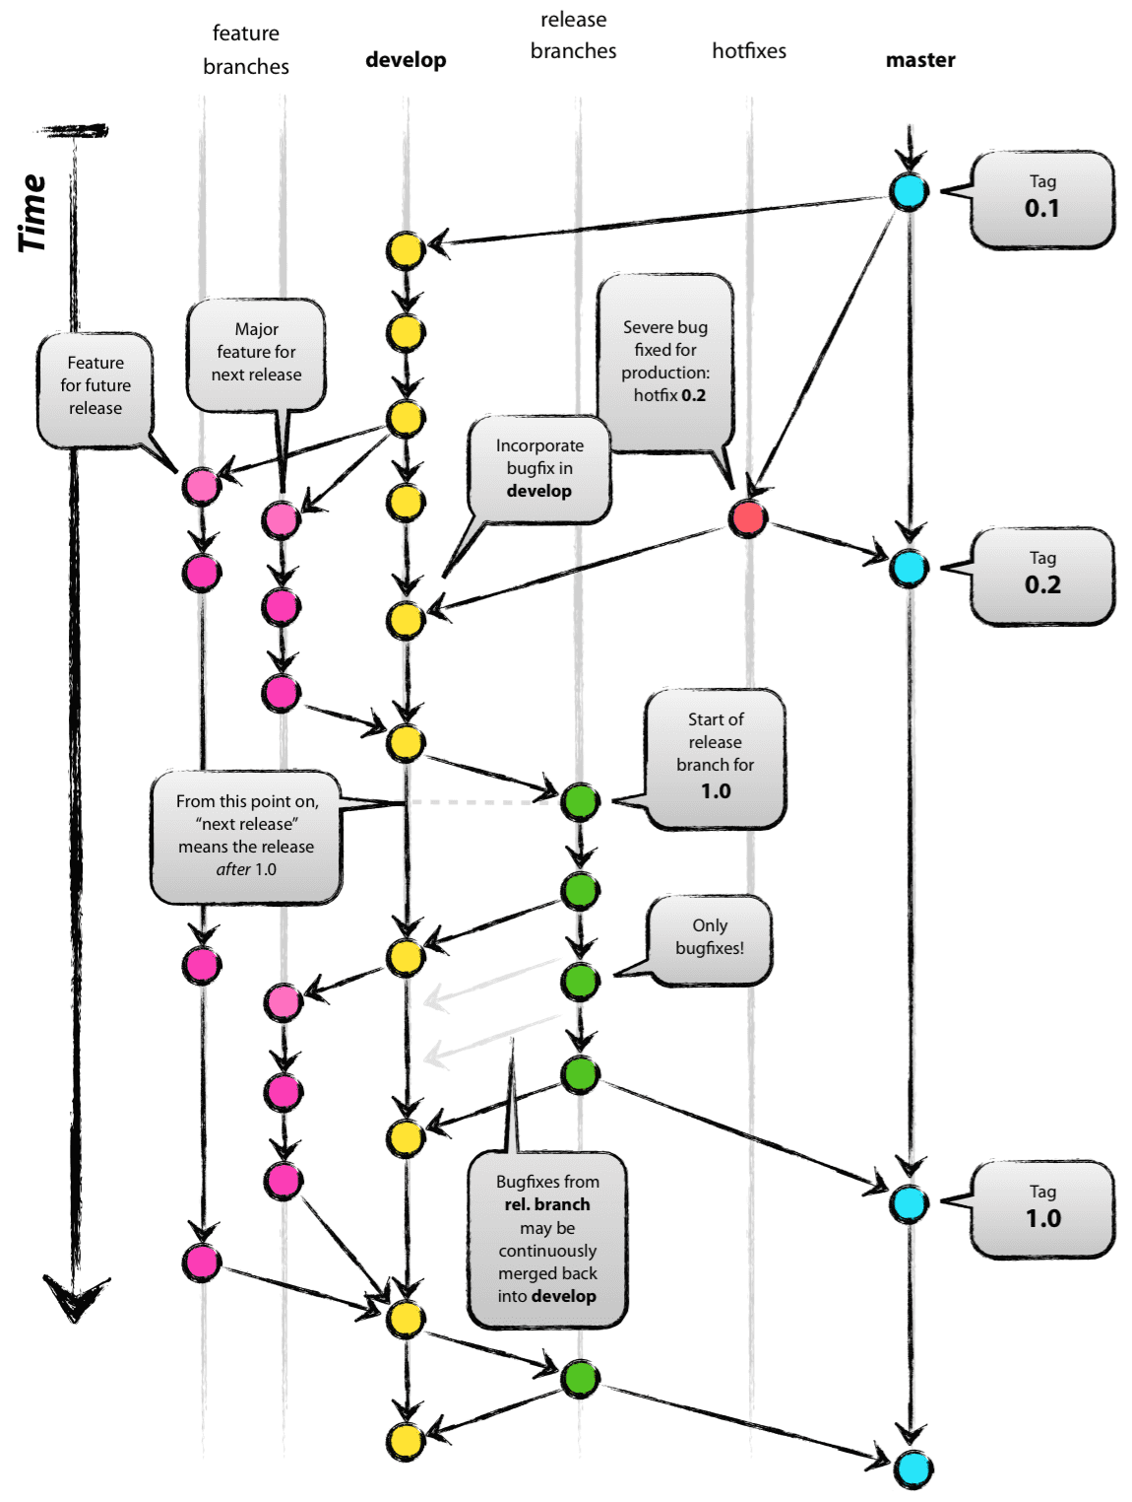

Slide 9
GITFlow
Advantages:
Facilitates features, release preparation and maintenance separately
Keeps Master branch production-ready
Helps in managing larger projects
Allows concurrent development on new features while making a new release
Allows quick fixes on live releases without creating a new full-fledged release
Disadvantages
Need to apply fixes on both Develop and Master. Forgetting this can make Develop out of date.
Too complicated for developers (Larger helper script developed to enforce the flow)
Longer-time-to-release cycle
Longer learning curve

Slide 10
ProGIT
Central Repository
Local Repository
myFeature
Master
Develop
My Feature
git checkout –b myFeature Master
Working Directory
test
test
push
Git status
Git add
Git commit

Slide 11
ProGIT
Advantages:
Same as GITHub
Protects Master branch
Less complicated than GitFlow
Disadvantages
No separate branches for releases

Slide 12
Forking
Starts with central server and repository
Each developer forks the repo. Does not clone
Continue in local repository like
When they push, instead of central server, they push to their copy of server
When done, create a pull request for admin to merge

Slide 13
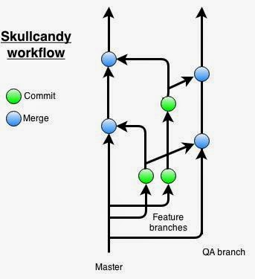
SkullCandy

Slide 14
SkullCandy
Works in Sprints
Create QA branch off Master
Create a separate Feature branch for each story off Master
Develop and finish the story by the end of the sprint
Push from Feature branch into QA branch
Once approved from QA, merge back to Master and release

Slide 15
SkullCandy
Advantages:
Coherence between issue tracking system and code repository
Easy tracking of features
Opportunity for auto-updating issue tracker for branch work and generating alerts to developers when branch gets released
Disadvantages

Slide 16
Summary of Evaluation
 | Centralized Control | GITHub Flow | GITFlow | ProGIT | SkullCandy
Helpful | Med | Med | Low | High | High
Complexity | Low | Low | High | Med | Med
Release lifecycle support | Low | Low | High | Low | Low
Quick fix support | Low | Med | High | Low | Low
Provides production-ready code | Low | Med | High | High | High

Slide 17
TechThree.io
Workflow:
Protected master branch
Separate branch for each feature
Separate “staging” and “production” branches
CICD pipeline for automated deployments
One Story/Task/Bug per branch
Code review before merger into master branch
Flow: master >> test >> production (Strictly)
Release tags

Slide 18
TechThree.io
Example:
A new feature “Switch between dark and light theme” to be added to Bubshub.
Scrum master creates a User story on Asana with a tag “bubsy-themes”.
Business analyst adds precise requirements and test cases on Asana for this story.
Developer picks this story during Sprint planning for delivery and adds details including story points, estimated time, due date, etc.
Developer creates a new branch from master and names it “bubsy-themes”.
Developer implements the functionality and writes tests for automated testing.
Developer creates a request for the Architect to merge into master branch.

Slide 19
TechThree.io
Example:
Architect reviews the code. Finds that the changed code was not formatted and that instead of a switch button, the developer had used a drop-down list.
Pull request is not accepted and goes back to the developer.
The developer addresses concerns raised during code review and makes another commit.
Architect merged bubsy-themes branch into master branch.
As the master branch is updated, the new code is redeployed on test instance.
Q/A team is tests the new app and verifies the requirements provided on Asana.
Q/A approves the task and the master branch is merged into staging branch.
One day before end of Sprint, the staging branch is merged into production branch with a new tag named as the updated version of the app.

